Slide 1
Chapter 7
Periodic properties of the elements

Slide 2
1. Electrons in the 1s subshell are much closer to the nucleus in Ar than in He due to the larger __________ in Ar.
A) nuclear charge
B) paramagnetism
C) diamagnetism
D) Hund's rule
E) azimuthal quantum number
A

Slide 3
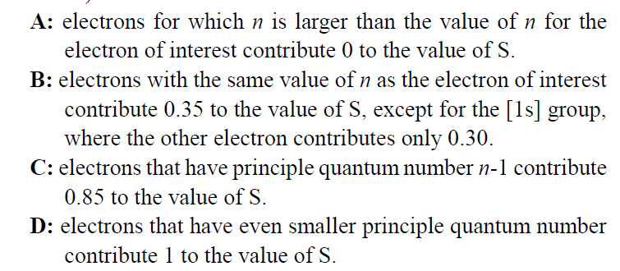
2. Screening of the nuclear charge by core electrons in atoms is __________.
A) less efficient than that by valence electrons
B) more efficient than that by valence electrons
C) essentially identical to that by valence electrons
D) responsible for a general decrease in atomic radius going down a group
E) both essentially identical to that by valence electrons and responsible for a general decrease in atomic radius going down a group
B

Slide 4
3. The atomic radius of main-group elements generally increases down a group because __________.
A) effective nuclear charge increases down a group
B) effective nuclear charge decreases down a group
C) effective nuclear charge zigzags down a group
D) the principal quantum number of the valence orbitals increases
E) both effective nuclear charge increases down a group and the principal quantum number of the valence orbitals increases
D

Slide 5
4. Of the following, which gives the correct order for atomic radius for Mg, Na, P, Si and Ar __________?
A) Mg > Na > P > Si > Ar
B) Ar > Si > P > Na > Mg
C) Si > P > Ar > Na > Mg
D) Na > Mg > Si > P > Ar
E) Ar > P > Si > Mg > Na
D

Slide 6
5. Which isoelectronic series is correctly arranged in order of increasing radius __________?
A) K⁺ < Ca²⁺ < Ar < Cl⁻
B) Cl⁻ < Ar < K⁺ < Ca²⁺
C) Ca²⁺ < Ar < K⁺ < Cl⁻
D) Ca²⁺ < K⁺ < Ar < Cl⁻
E) Ca²⁺ < K⁺ < Cl⁻ < Ar
D

Slide 7
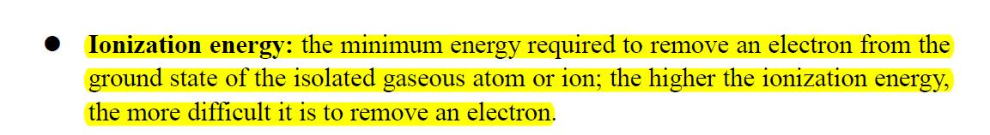
6. Of the choices below, which gives the order for first ionization energies __________?
A) Cl > S > Al > Ar > Si
B) Ar > Cl > S > Si > Al
C) Al > Si > S > Cl > Ar
D) Cl > S > Al > Si > Ar
E) S > Si > Cl > Al > Ar
B

Slide 8
7. __________ have the lowest first ionization energies of the groups listed.
A) Alkali metals
B) Transition elements
C) Halogens
D) Alkaline earth metals
E) Noble gases
A

Slide 9
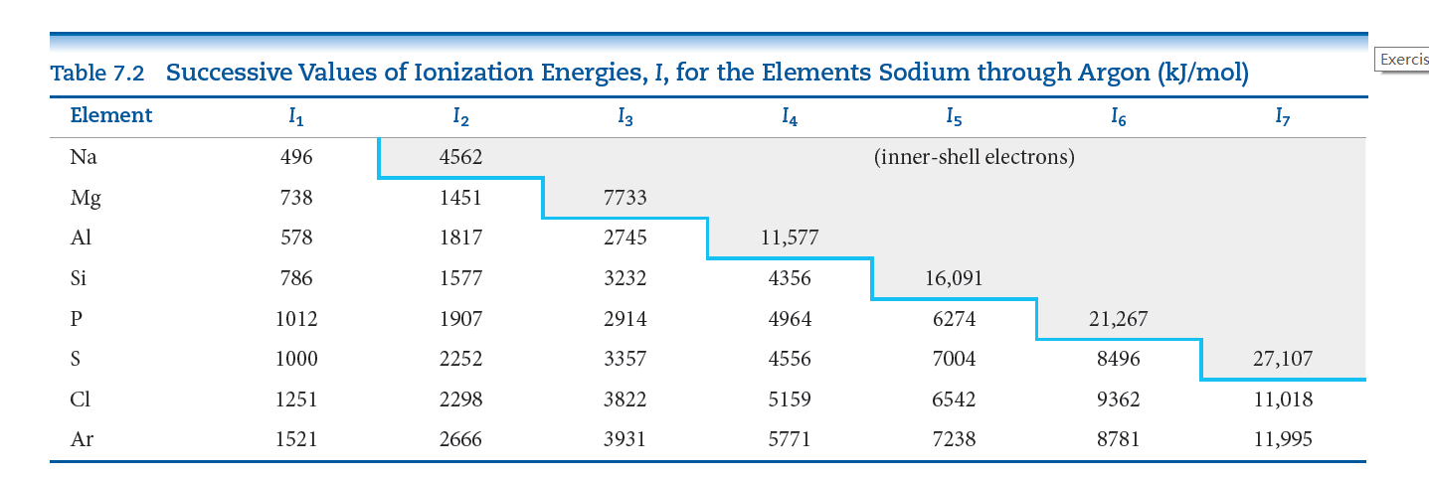
8. The electron configuration belonging to the atom with the highest second ionization energy is __________.
(i) 1s²2s²2p⁶3s¹
(ii) 1s²2s²2p⁶3s²
(iii) 1s²2s²2p⁶3s²3p¹
(iv) 1s²2s²2p⁶3s²3p⁴
(v) 1s²2s²2p⁶3s²3p⁵
A) (i)
B) (ii)
C) (iii)
D) (iv)
E) (v)
A
The trend is not followed when the added valence electron in the next element
enters a new sublevel (higher energy sublevel);
is the first electron to pair in one orbital of the sublevel (electron repulsions lower energy).

Slide 10
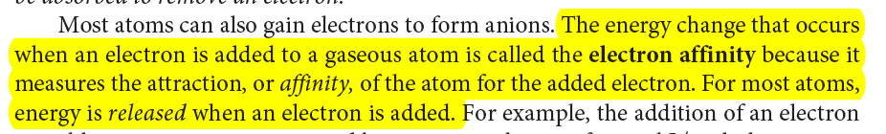
9. The electron configuration of the atom with the most negative electron affinity is __________.
(i) 1s²2s²2p⁶3s¹
(ii) 1s²2s²2p⁶3s²
(iii) 1s²2s²2p⁶3s²3p¹
(iv) 1s²2s²2p⁶3s²3p⁴
(v) 1s²2s²2p⁶3s²3p⁵
A) (i)
B) (ii)
C) (iii)
D) (iv)
E) (v)
E

Slide 11
10. Chlorine is much more apt to exist as an anion than is sodium. This is because __________.
A) chlorine is bigger than sodium
B) chlorine has a greater ionization energy than sodium does
C) chlorine has a greater electron affinity than sodium does
D) chlorine is a gas and sodium is a solid
E) chlorine is more metallic than sodium
C

Slide 12
11. In the generation of most anions, the energy change (kJ/mol) that _______ an electron is ________.
A) removes, positive
B) adds, positive
C) removes, negative
D) adds, negative
E) None of the above is correct
D

Slide 13
12. The list that correctly indicates the order of metallic character is __________.
A) B > N > C
B) F > Cl > S
C) Si > P > S
D) P > S > Se
E) Na > K > Rb
C

Slide 14
13. Transition metals within a period differ mainly in the number of __________ electrons.
A) s
B) p
C) d
D) f
E) all of the above
C

Slide 15
14. Consider the general valence electron configuration of ns²np⁵ and the following statements:
(i) Elements with this electron configuration are expected to form -1 anions.
(ii) Elements with this electron configuration are expected to have large positive electron affinities.
(iii) Elements with this electron configuration are nonmetals.
(iv) Elements with this electron configuration form acidic oxides.
Which statements are true __________?
A) (i) and (ii)
B) (i), (ii), and (iii)
C) (ii) and (iii)
D) (i), (iii,) and (iv)
E) All statements are true
D

Slide 16
15. This element is more reactive than lithium and magnesium but less reactive than potassium. This element is __________.
A) Na
B) Rb
C) Mn
D) Be
E) Fr
A

Slide 17
16. All of the halogens __________.
A) exist under ambient conditions as diatomic gases
B) tend to form positive ions of several different charges
C) tend to form negative ions of several different charges
D) exhibit metallic character
E) form salts with alkali metals with the formula MX
E

